Slide 1
Winter breakdown
Ms. Jefferson Cpa Science

Slide 2
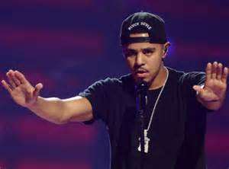
Blueprint
For each question there is an explanation
Some explanations are for multiple questions
No answers will be provided
You will use the explanations
to determine if your answer is
correct
The heading box (the section at the top of the slide) will include the topic and the questions that are being explained.
What.. No answer key????????????????

Slide 3
Acceleration: #1,2 , 3, &4
Acceleration
Acceleration is a vector which measures the change in the velocity of an object.
•Don’t forget that velocity is a vector, so it has magnitude and direction.
•This means acceleration could be any of the following three… 1.a change in speed, the magnitude of the velocity (from 34 km/h to 67 km/h)
2.a change in direction (from East to North-East)
3.a change in both speed and direction (from 34 km/h East to 12 km/h West)
Acceleration is a measure of the rate at which velocity changes.
Constant speed means that speed is not increasing or decreasing but remain consistent over time. It means that velocity is zero and thus, acceleration is also zero.

Slide 4
Potential energy: #4
i.Elastic Potential Energy a.Anything that can act like a spring or a rubber band can have elastic potential energy.
b.Let's take the rubber band for example. To stretch the rubber band you have to use energy. That energy has now been turned into elastic potential energy. To get that energy back, just let go of the rubber band and its potential energy is converted primarily into kinetic energy.
c.Springs work the same way, but you can either stretch or compress them. Wind-up watches store potential energy in an internal spring when you wind them and slowly use this energy to power the watch.
ii.Gravitational Potential Energy a.There is a constant attractive force between the Earth and everything surrounding it, due to gravity.
b.To lift something off the ground it takes energy, so just by lifting an object, that object now has higher gravitational potential energy.
c.Gravitational potential energy is typically converted into kinetic energy (an object falling) before it is converted into any other type of energy.
d.Hydroelectric power is generated this way. As the water falls, it turns a turbine, which pushes electrons around, creating an electric

Slide 5
Kinetic and Potential energy # 5
Kinetic energy is energy possessed by a body by virtue of its movement. Potential energy is the energy possessed by a body by virtue of its position or state.
 | Kinetic Energy | Potential Energy
Definition | The energy of a body or a system with respect to the motion of the body or of the particles in the system. | Potential Energy is the stored energy in an object or system because of its position or configuration.
Relation to environment | Kinetic energy of an object is relative to other moving and stationary objects in its immediate environment. | Potential energy is not relative to the environment of an object.
Transferability | Kinetic energy can be transferred from one moving object to another, say, in collisions. | Potential energy cannot be transferred.
Examples | Flowing water, such as when falling from a waterfall. | Water at the top of a waterfall, before the precipice.
SI Unit | Joule (J) | Joule (J)
Determining factors | Speed/velocity and mass | Height or distance and mass

Slide 6
Net Force: #6, 7,8

Slide 7
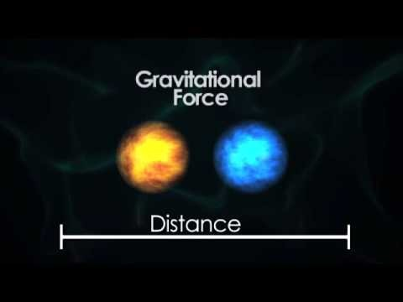
Factors affecting gravitation forces #9, 10

Slide 8
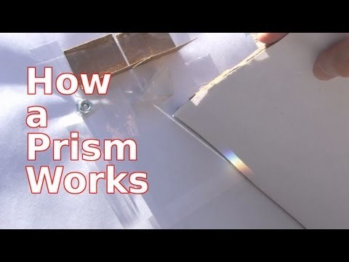
Visible light: #11, 12
http://studyjams.scholastic.com/studyjams/jams/science/energy-light-sound/light-absorb-reflect-refract.htm

Slide 9
Density: #13 & 14
Density is a property of matter that is unique to each substance. It is a measure of the mass of the substance in a standard unit of volume
Density = Mass ÷ Volume

Slide 10
Gravitational Potential energy #15, 16, 17
Gravitational potential energy is acquired by an object when it has been moved against a gravitational field. For example, an object raised above the surface of the Earth will gain energy, which is released if the object is allowed to fall back to the ground. In order for an object to be lifted vertically upwards, work must be done against the downward pull of gravity. This work is then stored as gravitational potential energy. When the object is released and falls towards the Earth, the potential is converted into kinetic energy, or movement.

Slide 11
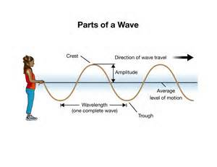
Waves: #23, 24,25, 27,

