Slide 1
What is Science
Lindsey/Stephens

Slide 2
Do Now
Indicate if you agree or disagree with the statements listed on the Do Now. You can use an “A” for agree and a “D” for disagree.

Slide 3
What is Science?
To investigate and understand nature.
To explain events in nature.
To use those explanations to make useful predictions.
That is what Science is!

Slide 5
What Science is and is not.
First: Science deals only with the natural world.
Second: Scientists collect an organize information
in a careful orderly way, looking for patterns and
connections between events.
Third: Scientist propose explanations that can be
tested by examining evidence.

Slide 7
Evidence Based on Observations
Involves using one or more of the senses:
Sight
Hearing
Touch
Smell
And sometimes taste
To gather information.
The information gathered is called EVIDENCE or DATA.

Slide 8
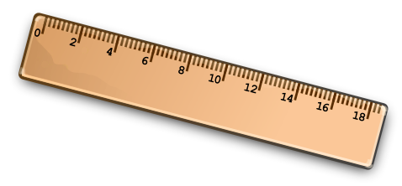
Two Types of Observations
Quantitative Observations:
Involves numbers.
FOR EXAMPLE:
Counting or measurements.
Qualitative Observations:
Characteristics that cannot be easily measured or counted.
FOR EXAMPLE:
Color or texture.

Slide 10
Interpreting the Evidence
Inference:
Is a logical interpretation based on prior knowledge
and experience.
EXAMPLE:
Researchers might sample water from a Reservoir in
different areas.
If they all test clean they will infer that all the water
in the reservoir is safe to drink.

Slide 11
Explaining the Evidence
Hypothesis:
A possible explanation for a set of observations or an
answer to a scientific question.
EXAMPLE:
Infectious disease spreads through the water source
of a community.
Scientists would run experiments to support or reject
the hypothesis.

Slide 13
Scientific View of the World
Everyday events are thought of in a Scientific way
without even realizing it.
EXAMPLE:
Car won’t start, its out of gas or the battery is dead.
This is a hypothesis.

Slide 14
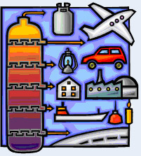
Science and Human Values
Public health and the environment raises many
questions on human values.
EXAMPLE:
The use of fossil fuels verses hydroelectric dams.
How should chemical wastes be disposed of?

Slide 15
Assessment
1. What does Science study?
What is the difference between
Qualitative and Quantitative
observations?
Give an example of each.
3. What is an hypothesis?
Give an example of an hypothesis.

