Slide 1
Chapter 9 - Solutions
Section 9.1 and Section 9.2

Slide 2
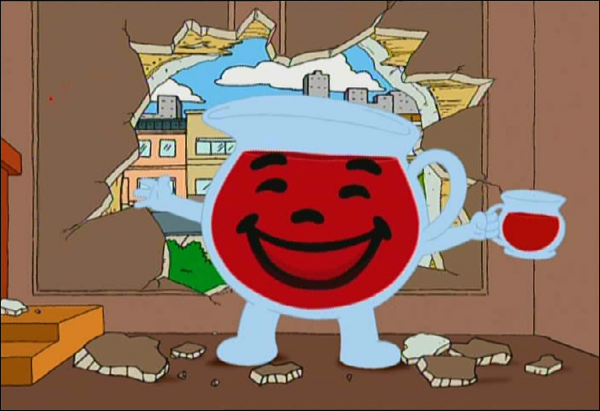
Two parts to a Solution
Solvent – the substance that makes up the biggest percentage of the mixture
Usually a liquid
Solute – the other substances in the solution
Dissolved in the solvent
Ex: Kool aid powder is the solute and water is the solvent that it is dissolved in

Slide 3
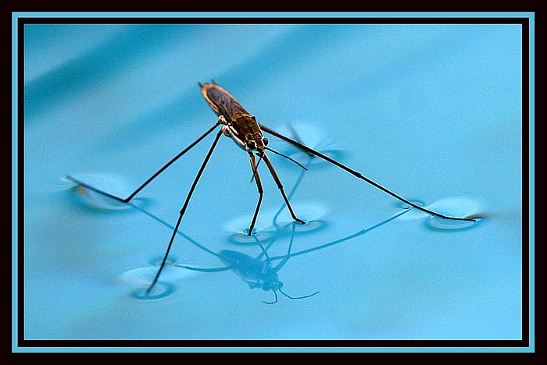
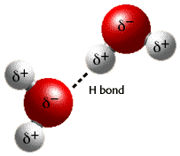
Hydrogen Bonding
Positive Hydrogen bonds from one water molecule are attracted to the negative Oxygen atoms in another water molecule
Surface Tension – a force that pulls molecules together on a liquid surface
Water Striders can walk on water!

Slide 4
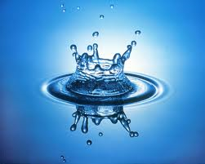
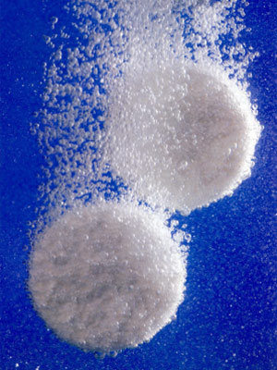
Water as a Solvent
“Universal Solvent”
Dissolves many substances such as salts and sugars
A solution with water as the solvent is an aqueous (aq) solution
Dissolved – term used to describe when molecules of solute are completely separated from each other and dispersed into a solution

Slide 5
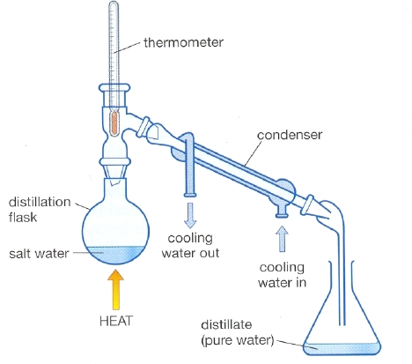
3 Types of Water used to make Solutions
Tap water – contains dissolved salts and minerals (Fe²⁺ Mg²⁺)
Deionized water – water that has its ions removed through filtration process
Distilled water – water purified by heating water to steam and then condensing it

Slide 6
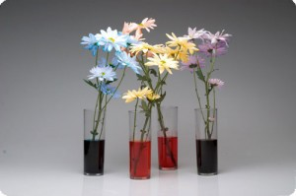
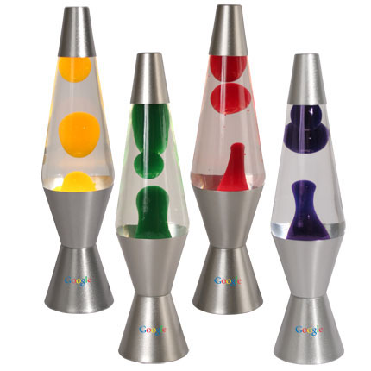
Like Dissolves Like
Polar compounds dissolve in polar solvents
Ex: food coloring dissolves and spreads out in water
Non-Polar compounds dissolve in non polar solvents
Ex: When added to mineral oil, food coloring forms drops and does not dissolve/mix in with the mineral oil
Ex: Wax is nonpolar and is used in lava lamps

Slide 7
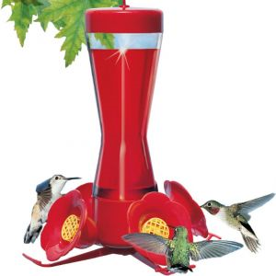
Concentration
Describes how much of each solute there is compared to the total solution
Higher concentration = more solute
Lower concentration = less solute
Dilute Solution – very little solute present
Low concentration
Concentrated solution – a solution with a lot of solute compared to solvent
High concentration
Hummingbirds prefer flowers with high sugar concentration

Slide 8
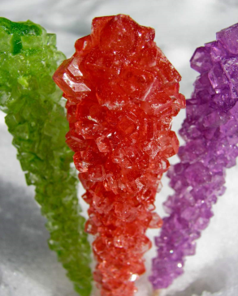
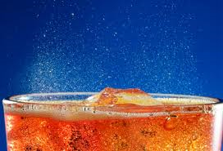
Saturation
Rock candy is made by supersaturated a solution and then letting the excess sugar settle out
A solution is Saturated if it contains as much solute as the solvent can dissolve
Ex: When sugar settles to the bottom of a glass, the solution already contains as much sugar as it can hold
A solution is Supersaturated when it contains more dissolved solute than it can hold
Ex: pop is supersaturated with CO₂ causing it to fizz to release the CO₂ gas

Slide 9
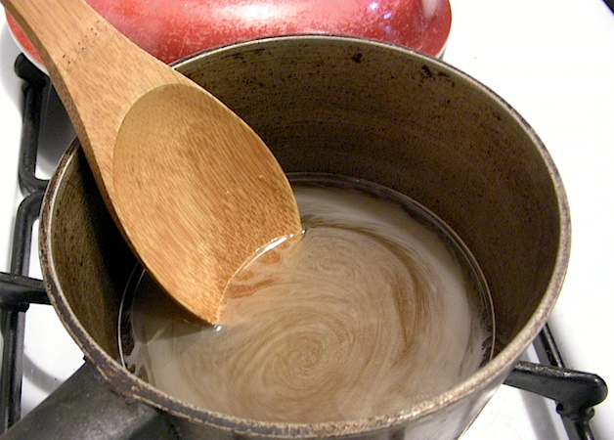
Dissolving rate
The process of Dissolving occurs faster when:
The solutes are ground into a fine powder – increased surface area
you increase the temperature
Stirring also increases the rate of dissolving by increasing the temperature
You increase the amount of solvent present

Slide 10
Two ways to calculate the concentration of a solution
Molarity - The number of moles of solute in a Liter of solution
Percent concentration – the percentage of the solution that is made up of the element(s) in question
$Percent concentration= \frac{mass of solute}{total mass of solution}$ x 100

