Slide 1
Observations and Inferences

Slide 2
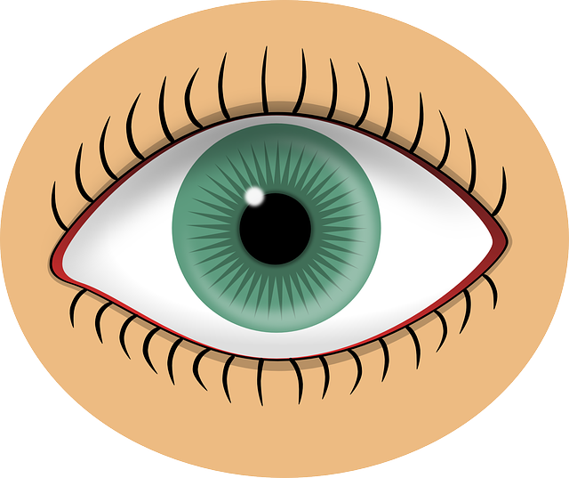
Observations
An observation is something you notice, measure, or detect.
You make observations using your 5 senses:
sight
smell
taste
touch
hearing

Slide 3
Qualitative observations
Things you notice using your senses that can’t be measured
Examples: color, texture, smell

Slide 4
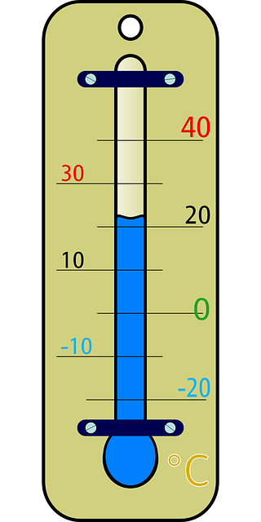
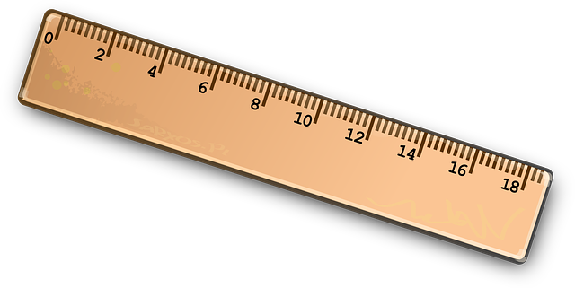
Quantitative Observations
Measureable characteristics
Anything that can be measured with something like a ruler, scale, thermometer, or graduated cylinder

Slide 5
Observations
Scientific observations are based on facts (things you see or measure), not opinions, feelings, or ideas.

Slide 6
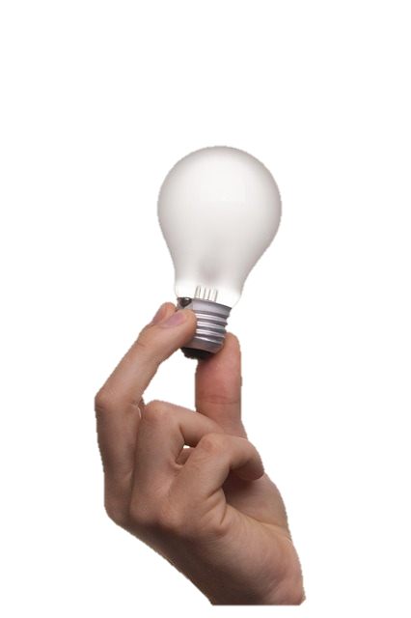
Inferences
An inference is an idea formed from facts or evidence.
Evidence is proof that supports an idea.

Slide 7
Scientific observations help scientists make inferences.
An inference that can be tested is called a hypothesis.

