Slide 1
Graphing Data
Ms. Jefferson

Slide 2
Introduction
Graphing is used by scientists to display the data that is collected during a controlled experiment.
A line graph must be constructed to accurately depict the data collected.
LINE GRAPHS SHOW THE RELATIONSHIP BETWEEN THE INDEPENDENT VARIABLE AND DEPENDENT VARIABLE
An incorrect graph often leads to the acceptance of an incorrect hypothesis or detract from the acceptance of a correct hypothesis. A graph should contain 4 major parts: the title, the independent variable, the dependent variable, and the scales for each variable.

Slide 3
Title
this shows what the graph is about. Reading the title should give the reader an idea about the graph. It should be a concise statement placed above the graph.
It shows the relationship between the independent and dependent variables.

Slide 4
X-Axis
The Independent Variable: this is the variable (part of the experiment that changes)
That can be controlled or manipulated by the experimenter. This variable should be placed on the horizontal or x-axis.

Slide 5
Y-Axis
The Dependent Variable: this is the variable directly affected by the independent variable.
It is the result of what happens because of the independent variable. This variable is placed on the y or vertical axis.

Slide 6
The Scale
The Scales for each Variable:
Each block should have a consistent amount or increment on a particular axis.
While the scale should allow as much of the graph to be taken up as possible, it is not a good idea to set up a scale that is hard to manage.
For example, multiples of 5, 10, etc. are good, while multiples such as 1.22 are not! Your scale must be plotted on the amount of graph space available, and will be dictated by the data points.

Slide 7
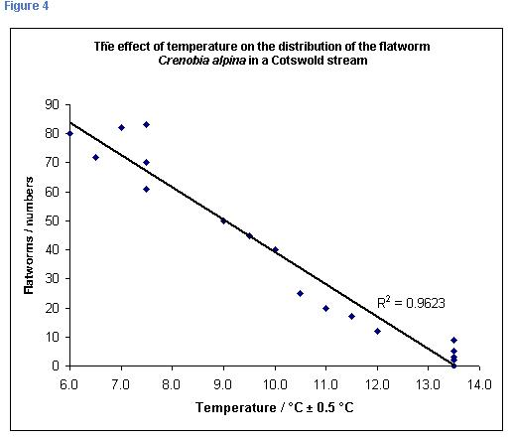
Example

