Slide 1
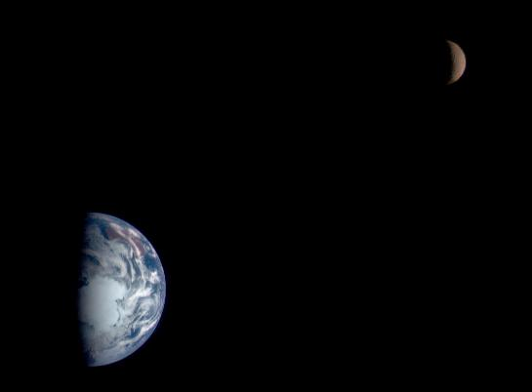
Earth Systems Overview
The Earth is a system consisting of four major interacting components:
the atmosphere,
the biosphere,
the hydrosphere, and
the geosphere
Let’s examine each of these four spheres in detail………
Notes:
*
Image is from the following website: http://apod.nasa.gov/apod/ap980129.html

Slide 2
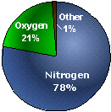
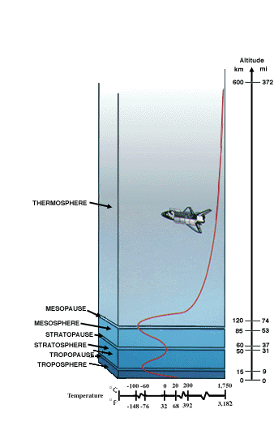
The Atmosphere
The Earth is surrounded by a blanket of air, which we call the atmosphere.
The atmosphere consists of four unique layers (the troposphere, the stratosphere, the mesosphere, and the thermosphere).
The atmosphere reaches over 560 kilometers (348 miles) up from the surface of the Earth.
The atmosphere is primarily composed of nitrogen (about 78%) and oxygen (about 21%). Other components exist in small quantities.
Notes:
*
Images are from the following website: http://liftoff.msfc.nasa.gov/academy/space/atmosphere.html
Atmo means “vapor”, so this is the sphere of (water) vapor.

Slide 3
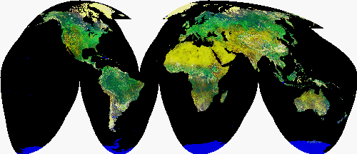
The Biosphere
The biosphere is the “life zone” of the Earth, and includes all living organisms (including humans), and all organic matter that has not yet decomposed.
The biosphere is structured into a hierarchy known as the food chain (all life is dependant on the first tier – mainly the primary producers that are capable of photosynthesis).
Energy and mass is transferred from one level of the food chain to the next.
Notes:
*
Image is from the following website: http://www.geology.ufl.edu/Biosphere.html
Bio means “life”, so this is the sphere of life.

Slide 4
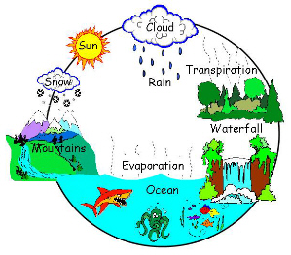
Hydrosphere
The hydrosphere contains all the water found on our planet.
Water found on the surface of our planet includes the ocean as well as water from lakes and rivers, streams, and creeks.
Water found under the surface of our planet includes water trapped in the soil and groundwater.
Water found in our atmosphere includes water vapor.
Frozen water on our planet includes ice caps and glaciers.
Only about 3% of the water on Earth is “fresh” water, and about 70% of the fresh water is frozen in the form of glacial ice.
Notes:
*
Image is from the website: http://water.tamu.edu/watercycle.html
Hydro means “water”, so this is the sphere of water.

Slide 6
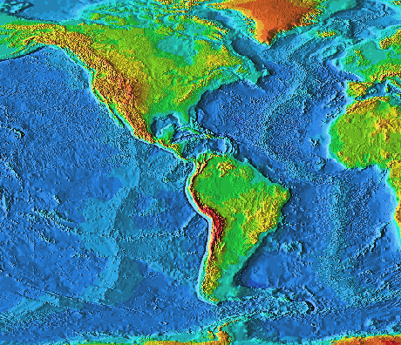
Geosphere
The geosphere is the solid Earth that includes the continental and ocean crust as well the various layers of Earth’s interior.
94% of the Earth is composed of the elements oxygen, silicon, and magnesium.
The geopsphere is not static (unchanging), but its surface (crust) is in a constant state of motion.
Mineral resources are mined from the geosphere.
Notes:
*
Image is from the website: http://ess.geology.ufl.edu/ess/Introduction/Geosphere.html

Slide 7
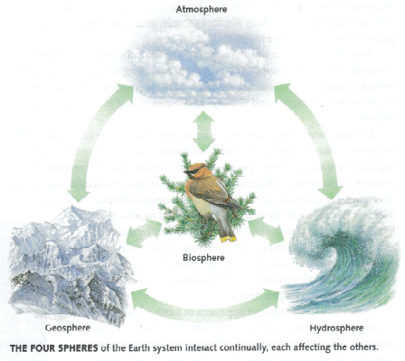
Earth System Science
Earth System Science is the study of how the four spheres of the Earth system interact continually, each affecting the others.
Let’s look at a couple of examples of how a change in one system (or sphere) affects other Earth systems.
Notes:
*
The Earth system refers to the fact that we use models to look at parts of the Earth, helping us to describe what has happened in the past, what is currently happening, and what might happen in the future.

Slide 8
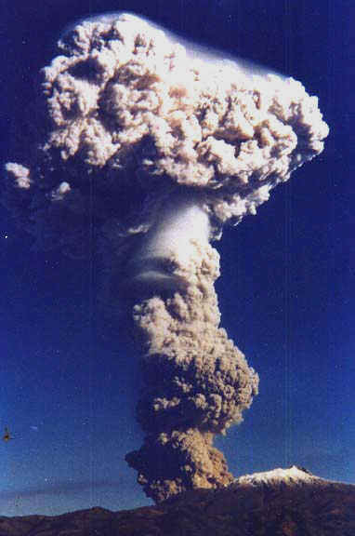
System Interactions
Volcanoes (geosphere) erupt, sending ash and gases into the air (atmosphere) and sending lava and ash down onto surrounding forests (biosphere) and human habitations (biosphere).
Geosphere
Atmosphere
Biosphere
Notes:
*
Image is from the website: http://www.ecuador-travel.net/information.volcano.pichincha.eruption.htm

Slide 9
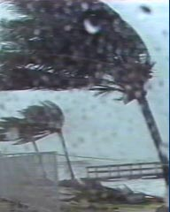
System Interactions
Hurricanes (atmosphere) sweep across the ocean (hydrosphere) and onto the land (geosphere), damaging the dwellings of people (biosphere) who live along the coast.
Hydrosphere
Atmosphere
Geosphere
Biosphere
Notes:
*
Image is from the website: http://www.itvs.org/risingwaters/

Slide 10
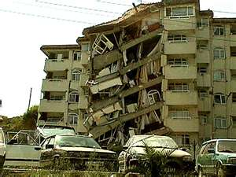
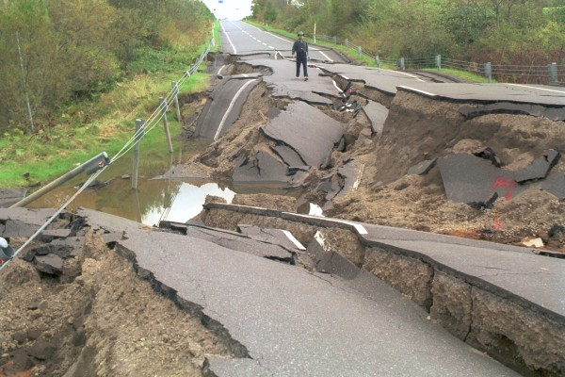
System Interactions
Earthquakes (geosphere) can damage buildings which may kill people (biosphere), as well as cause fires which release gases into the air (atmosphere). Earthquakes in the ocean may cause a tsunami (hydrosphere) which can eventually hit land and kill both animals and people (biosphere).
Biosphere
Geosphere
Atmosphere
Hydrosphere
Notes:
*
Image is from the website: http://www.seismo.unr.edu/ep/nvguide/ep6.html

